Slide 1
Beginning Perl-Biologist’s Perspective
Jun Wang
MPI Ploen

Slide 2
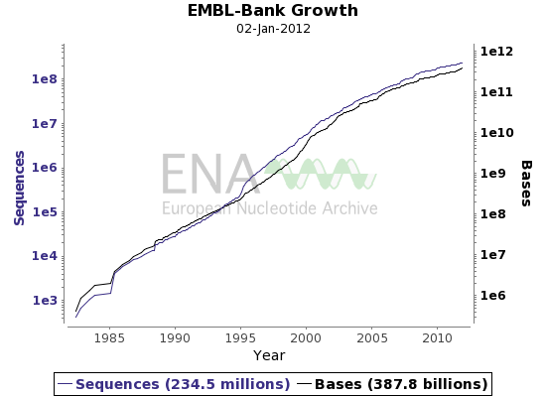
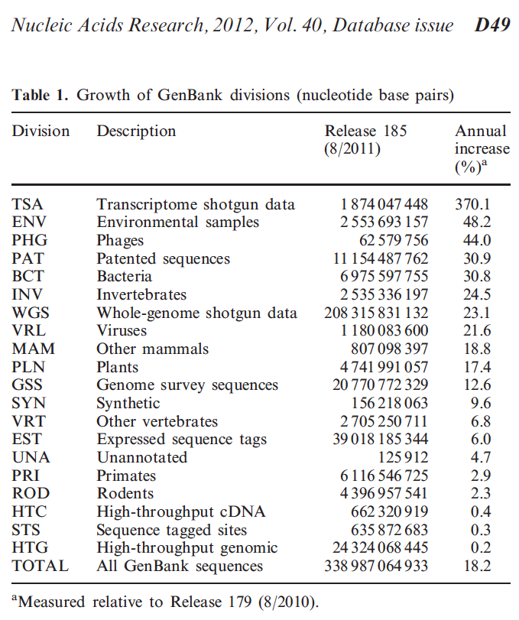
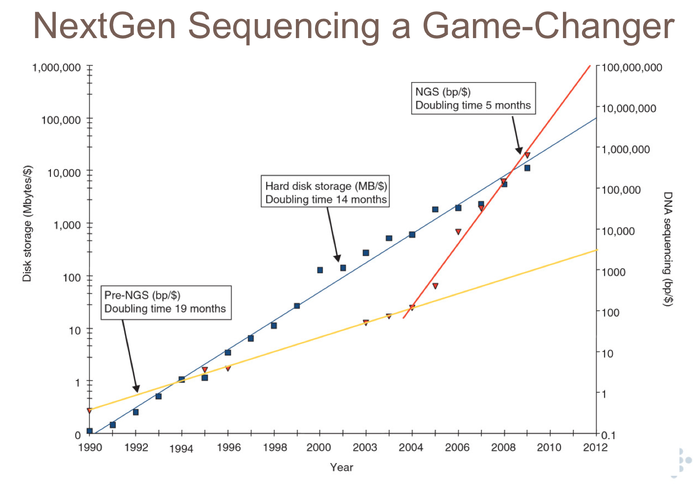
http://www.ebi.ac.uk
http://ivory.idyll.org/

Slide 3

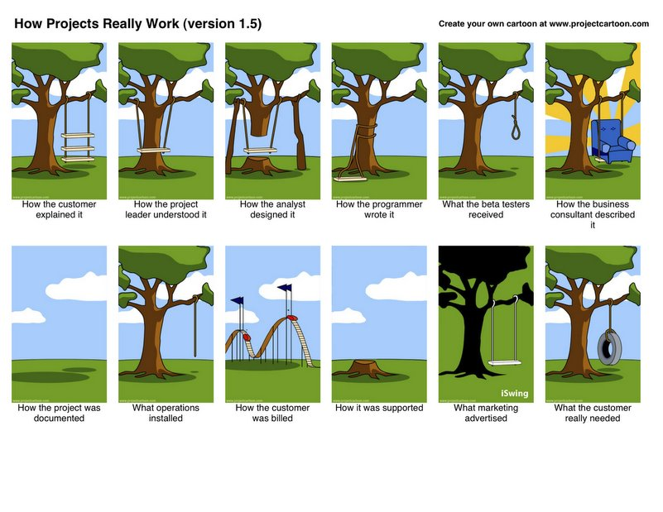
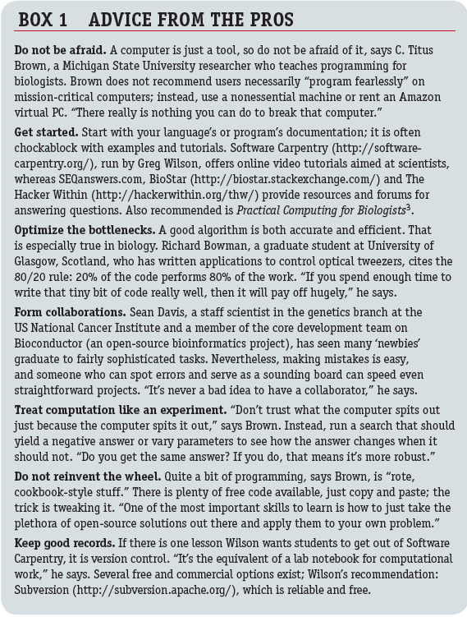

Slide 4
Use Perl!
Open source and human readable
Enough packages and support
(relatively) Easy to begin
A bit slow (Perl 6 is coming)…

Slide 5
1, Your first Perl program
Save “hello.pl” with:
#! usr/bin/perl
# world tradition since 1974….
print “Hello world! ”;
Invoke with ‘perl hello.pl’ or ‘hello.pl’.

Slide 6
2, type of variables in Perl
Define by “my ” and check by “ref”
Specific ones “use vars ….”
2,1 scalar ($)
Define $id1, $id2, $id3….
$seq1, $seq2, $seq3….
Cat $id1.$seq1
Length($seq1) and substr($seq1)
Compare scalar (eq , ne, gt, lt, gt, le; ==, !=, >, <, >=, <=)

Slide 7
2,2 arrays (@)
My @id=($id1, $id2…) or qw ()
My @seq=($seq1, $seq2…)
Get elements
  Foreach
  $id[0]….
  Shift @
  pop @
  Push
Join
$n=@

Slide 8
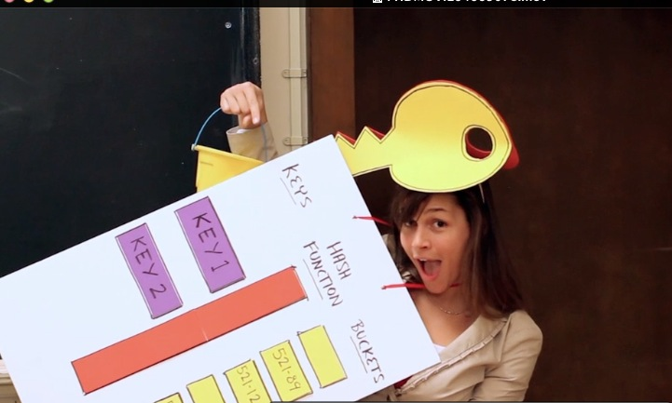
2,3 hash (%)
{‘id1’=>seq1, ‘id2’=>’seq2’….}
Or $hash{$id1}=$seq1;
Keys & values
Delete key
Reverse….
2.4 reference
  Will cover later

Slide 9
3, input/output and file I/O
Input <STDIN> and $ARGV[0]…
  Input a id and get sequence via hash
  More complex “getoption”
Output (print and >)

Slide 10
File I/O: through FILEHANDLE
Read file
Open (FILEHANDLE, “(option)” “filename”);
  Get content in @
  Remember to chomp (end of line)
Write file
Open (FILEHANDLE, “(option)” “filename”);
Print FILEHANDLE @
Remember to close FILEHANDLE…

Slide 11
4, flow control and conditional test
Flow control (on multiple variables)
  For and while
  (foreach)
Conditional test (just one variable)
  if/(elsif)/else && unless
  && (and) and || (or)

Slide 12
5, regular expressions
Patterns
5,1 match
$s=~ m/pattern/(options);
or $s=~ m/(pattern 1) (pattern 2)../ and get $1, $2…
5,2 substitute
$s=~ s/pattern1/pattern2/ (options);
5,3 translate
$s=~ t/pattern1/pattern2/…
5.4 split
@ =split /pattern/, $s;

Slide 13
Special cases (wild cards, learn when use)
  Symbols: \, \.
  \s and \t
  \w \W and \d \D
  . (any letter), *(0,1,2…), + (1,2…), ? (0,1)…
Options
  ^ and $
  [] and [^… ]
  A-Z or a-z
  g, i, …..

Slide 14
6, subroutine
Make your own functions
sub function
  {
  #read in the input
  my (@)=@_ or my $=$_[0];
  #do something
  return @ or $ or …
  }
When use more functions and frequently—write a perl module

Slide 15
7, references
When making more complex structures
  Array with sequences with separate sequences and ids (array of arrays/hashes)
  Or hash of hashes (sequences), or arrays
When use arrays/hashes for input of subroutines

Slide 16
8, learning from mistakes
Use “use warnings;”
Use “use diagnostics;”
Use “die “……”; ”
Try to use perl to speed up daily work

